Slide 1
How Elections Should
Really Be Run
Josh Benaloh
Senior Cryptographer
Microsoft Research

Slide 2
Disclaimer
Any opinions presented in this talk are my own and do not necessary represent those of the Microsoft Corporation or any subsidiary or partner thereof.

Slide 3
The Year Is …
2008

Slide 4
Sophisticated Mathematics
0
5
4 2008.00
2
1
.99
Remainder appears to be statistically near to zero.

Slide 5
This year …
… there will be a U.S. Presidential election.
(Don’t tell, maybe no one will notice.)

Slide 6
The Current Voting Landscape

Slide 7
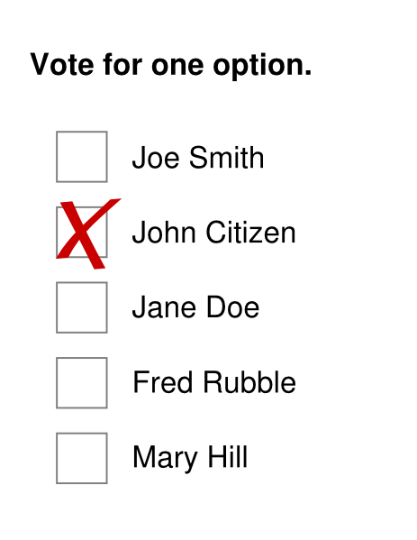
The Current Voting Landscape
Hand-Counted Paper

Slide 8
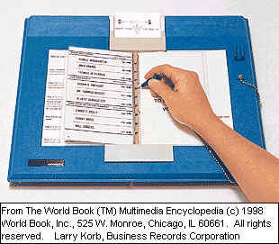
The Current Voting Landscape
Hand-Counted Paper
Punch Cards

Slide 9
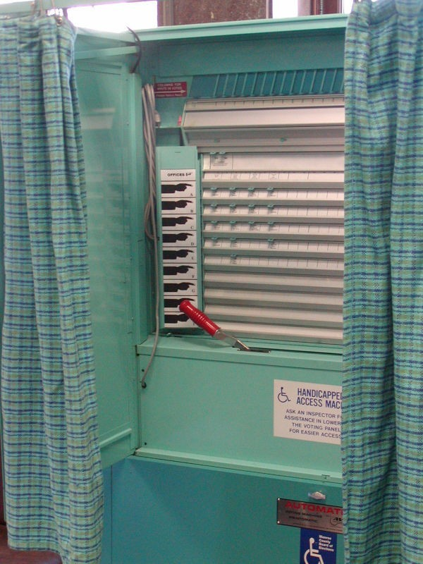
The Current Voting Landscape
Hand-Counted Paper
Punch Cards
Lever Machines

Slide 10
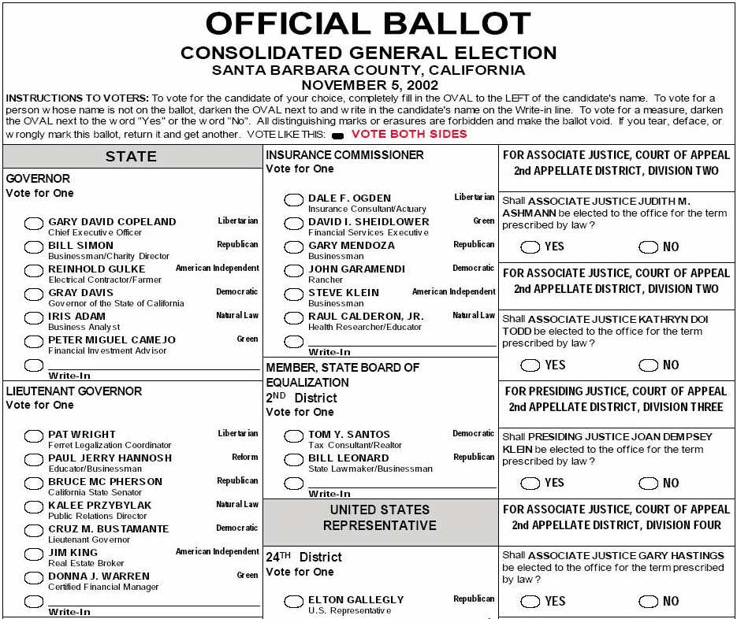
The Current Voting Landscape
Hand-Counted Paper
Punch Cards
Lever Machines
Optical Scan Ballots

Slide 11
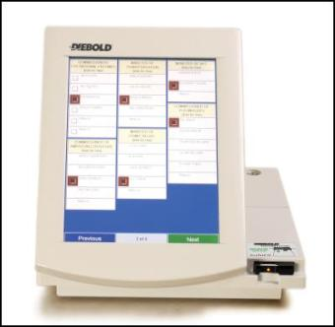
The Current Voting Landscape
Hand-Counted Paper
Punch Cards
Lever Machines
Optical Scan Ballots
Touch-Screen Terminals

Slide 12
The Current Voting Landscape
Hand-Counted Paper
Punch Cards
Lever Machines
Optical Scan Ballots
Touch-Screen Terminals
Various Hybrids

Slide 13
Vulnerabilities and Trust
All of these systems have substantial vulnerabilities.
All of these systems require trust in the honesty and expertise of election officials.
Can we do better?

Slide 14
End-to-End Voter-Verifiability
As a voter, I can be sure that
My vote is
  Cast as intended
  Counted as cast
All votes are counted as cast
… without having to trust anyone or anything.

Slide 15
Lloyd Bentsen Syndrome:
I know computers…
I’ve worked with computers…
You cannot trust computers.

Slide 16
More specifically …
There are a million ways to tamper with software:
Insider attacks
Exploitation of bugs and vulnerabilities
Configuration errors
etc.
How can one trust an election to software?

Slide 17
A Web-Based Election
Voters post their names and votes to a public web site.
Anyone who cares to do so can
  Check that their own votes are correctly posted
  Check that other voters are legitimate
  Check that the totals are correct

Slide 18
But wait …
This isn’t a secret-ballot election.
Quite true, but it’s enough to show that voter-verifiability is possible
… and also to falsify arguments that electronic elections are inherently untrustworthy.

Slide 19
Privacy
The only ingredient missing from this “toy” web-based election is privacy – and the things which flow from privacy (e.g. protection from coercion).
Performing tasks while preserving privacy is the bailiwick of cryptography.
Cryptographic techniques can enable end-to-end verifiable elections while preserving voter privacy.

Slide 20
End-to-End Verifiable Elections
Voters post their names and encrypted votes to a public web site.
At the end of the election, administrators post the tally together with a cryptographic proof that the tally “matches” the set of encrypted votes.

Slide 21
End-to-End Verifiable Elections
Anyone who cares to do so can
  Check that their own encrypted votes are correctly posted
  Check that other voters are legitimate
  Check the cryptographic proof of the correctness of the announced tally

Slide 22
Is it Really This Easy?
Yes …
… but there are lots of details to get right.

Slide 23
Some Important Details
How is the ballot encryption and decryption done?
How is the cryptographic proof of the tally done?

Slide 24
Some Principles of Election Protocols
Privacy
Verifiability
Robustness
Coercibility

Slide 25
Privacy
Only one voter?
A unanimous tally?
Unanimous less one?
Copy cats?

Slide 26
Verifiability
By single trusted party?
By trusted committee?
By each voter?
By observers?

Slide 27
Robustness
Against faulty/malicious voters?
Against faulty/malicious officials?
At what cost to privacy?

Slide 28
Coercibility
When?
By whom? (voter, official, or observer)
Where?
Free-form ballots?

Slide 29
Coercibility
Before the vote?
During the vote?
After the vote?
By voter, inspector, or observer?
Free-form ballots?

Slide 30
Current Election Methods
Currently deployed touch-screen systems have good usability properties but no substantive verifiability.
Paper-based systems offer some verifiability, but voters can only track their votes to a limited extent.
Perhaps we can do even better.

Slide 31
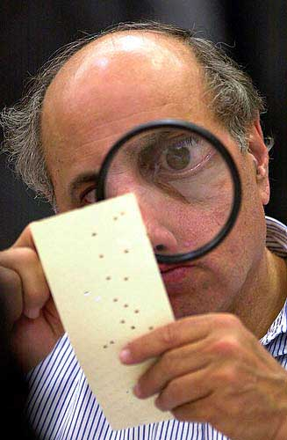
Current Election Methods
Currently deployed touch-screen systems have good usability properties but no substantive verifiability.
Paper-based systems offer some verifiability, but voters can only track their votes to a limited extent. At best, voters can ensure that their intended votes went into a locked ballot box, but they must depend upon officials and procedures to ensure that their votes are included in the tally.

Slide 32
True Verifiability
With well-built paper-based systems, voters can ensure that their intended votes went into a locked ballot box but must depend upon officials and procedures to ensure that their votes are included in the tally.
“Open-audit” methods can give voters complete confidence that their intended votes were properly included in the tally.

Slide 33
Cryptographic Verifiability
Many excellent cryptographic election schemes with very strong verifiability properties have been devised.
The principal shortcomings of these schemes is their complexity …
  Computational
  Implementation
  Conceptual
  Operational

Slide 34
Reducing Complexity
Two tenets of this work
The entire system should be as conceptually simple as possible.
Nothing more should be required of voters than in current voting systems.

Slide 35
Open-Audit Voting Systems
There are many approaches to open-audit voting, but the primary options can be divided into two phases.
Voters transform their intentions into encrypted ballots and post their (named) ballots on a public list.
The list of encrypted votes is publicly processed to produce a tally and a proof that the tally is correct.

Slide 36
The Encryption Phase
Turning your intentions into an encrypted ballot should be easy – no?
You can use your own machine.
You can use any machine you trust.
You can use a dedicated device.
Researchers regarded this phase as uninteresting.

Slide 37
The Tallying Phase
Taking a set of encrypted ballots and transforming it, in a universally verifiable manner, into a tally (together with a proof of correctness) is a nice cryptographic mathematical problem.
Researchers really liked this problem and spent decades developing and improving solutions.

Slide 38
Fundamental Tallying Decision
You have essentially two paradigms to choose from …
Anonymized Ballots
(Mix Networks)
Ballotless Tallying
(Homomorphic Encryption)

Slide 39
Anonymized Ballots

Slide 40
Ballotless Tallying

Slide 41
Pros and Cons of Ballots
Ballots simplify write-ins.
Ballots make it harder to enforce privacy.

Slide 42
Ballotless
Tallying

Slide 43
The Homomorphic Paradigm
  Benaloh (Cohen), Fischer (1985) …

Slide 44
The Homomorphic Paradigm
Tally

Slide 45
The Homomorphic Paradigm
Tally

Slide 46
Homomorphic Encryption
It is possible to construct public-key encryption functions such that if A is an encryption of a and B is an encryption of b then A×B is an encryption of a+b.
(A∈E(a)) ∧ (B∈E(b)) ⇒ (A×B∈E(a+b))

Slide 47
Homomorphic Encryption
In particular, given an encryption M∈E(m) , one can create a different M’∈E(m) by generating an encryption of zero Z∈E(0) and forming M’=MZ.

Slide 48
Homomorphic Encryption
Some Homomorphic Functions
RSA: E(m) = m^{e} mod n
ElGamal: E(m,r) = (g^{r},mh^{r}) mod p
Benaloh: E(m,r) = r^{x}g^{m} mod n
Pallier: E(m,r) = r^{n}g^{m} mod n²

Slide 49
Homomorphic Techniques
Alice | 0
Bob | 0
Carol | 1
David | 0
Eve | 1

Slide 50
Homomorphic Techniques
Alice | 0
Bob | 0
Carol | 1
David | 0
Eve | 1
 | Σ =

Slide 51
Homomorphic Techniques
Alice | 0
Bob | 0
Carol | 1
David | 0
Eve | 1
 | Σ =
 | 2

Slide 52
Homomorphic Techniques
Alice | 0
Bob | 0
Carol | 1
David | 0
Eve | 1

Slide 53
Homomorphic Techniques
Alice | 0
Bob | 0
Carol | 1
David | 0
Eve | 1

Slide 54
Homomorphic Techniques
Alice | 0
Bob | 0
Carol | 1
David | 0
Eve | 1
 | ⊗=
 | 2

Slide 55
Homomorphic Techniques
Alice | 0
Bob | 0
Carol | 1
David | 0
Eve | 1
 | ⊗=
 | 2

Slide 56
Homomorphic Techniques
The product of the encryptions of the votes constitutes an encryption of the sum of the votes.

Slide 57
The Homomorphic Paradigm
Tally

Slide 58
Homomorphic Techniques
Alice | 0
Bob | 0
Carol | 1
David | 0
Eve | 1

Slide 59
Homomorphic Techniques
 |  |  | X₁ | X₂ | X₃
Alice | 0 | = Σ | 3 | -5 | 2
Bob | 0 | = Σ | -4 | 5 | -1
Carol | 1 | = Σ | 2 | -3 | 2
David | 0 | = Σ | -2 | -1 | 3
Eve | 1 | = Σ | 4 | -1 | -2

Slide 60
Homomorphic Techniques
 |  |  | X₁ | X₂ | X₃
Alice | 0 | = Σ | 3 | -5 | 2
Bob | 0 | = Σ | -4 | 5 | -1
Carol | 1 | = Σ | 2 | -3 | 2
David | 0 | = Σ | -2 | -1 | 3
Eve | 1 | = Σ | 4 | -1 | -2
 |  |  | Σ = | Σ = | Σ =

Slide 61
Homomorphic Techniques
 |  |  | X₁ | X₂ | X₃
Alice | 0 | = Σ | 3 | -5 | 2
Bob | 0 | = Σ | -4 | 5 | -1
Carol | 1 | = Σ | 2 | -3 | 2
David | 0 | = Σ | -2 | -1 | 3
Eve | 1 | = Σ | 4 | -1 | -2
 |  |  | Σ = | Σ = | Σ =
 |  |  | 3 | -5 | 4

Slide 62
Homomorphic Techniques
 |  |  | X₁ | X₂ | X₃
Alice | 0 | = Σ | 3 | -5 | 2
Bob | 0 | = Σ | -4 | 5 | -1
Carol | 1 | = Σ | 2 | -3 | 2
David | 0 | = Σ | -2 | -1 | 3
Eve | 1 | = Σ | 4 | -1 | -2
 |  |  | Σ = | Σ = | Σ =
 |  | = Σ | 3 | -5 | 4

Slide 63
Homomorphic Techniques
 |  |  | X₁ | X₂ | X₃
Alice | 0 | = Σ | 3 | -5 | 2
Bob | 0 | = Σ | -4 | 5 | -1
Carol | 1 | = Σ | 2 | -3 | 2
David | 0 | = Σ | -2 | -1 | 3
Eve | 1 | = Σ | 4 | -1 | -2
 |  |  | Σ = | Σ = | Σ =
 | 2 | = Σ | 3 | -5 | 4

Slide 64
Homomorphic Techniques
 |  |  | X₁ | X₂ | X₃
Alice | 0 | = Σ | 3 | -5 | 2
Bob | 0 | = Σ | -4 | 5 | -1
Carol | 1 | = Σ | 2 | -3 | 2
David | 0 | = Σ | -2 | -1 | 3
Eve | 1 | = Σ | 4 | -1 | -2
 | Σ = |  | Σ = | Σ = | Σ =
 | 2 | = Σ | 3 | -5 | 4

Slide 65
Homomorphic Techniques
The sum of the shares of the votes constitute shares of the sum of the votes.

Slide 66
Homomorphic Techniques
 |  |  | X₁ | X₂ | X₃
Alice | 0 | = Σ | 3 | -5 | 2
Bob | 0 | = Σ | -4 | 5 | -1
Carol | 1 | = Σ | 2 | -3 | 2
David | 0 | = Σ | -2 | -1 | 3
Eve | 1 | = Σ | 4 | -1 | -2
 | Σ = |  | Σ = | Σ = | Σ =
 | 2 | = Σ | 3 | -5 | 4

Slide 67
Homomorphic Techniques
 |  |  | X₁ | X₂ | X₃
Alice | 0 |  | 3 | -5 | 2
Bob | 0 |  | -4 | 5 | -1
Carol | 1 |  | 2 | -3 | 2
David | 0 |  | -2 | -1 | 3
Eve | 1 |  | 4 | -1 | -2

Slide 68
Homomorphic Techniques
 |  |  | X₁ | X₂ | X₃
Alice | 0 |  | 3 | -5 | 2
Bob | 0 |  | -4 | 5 | -1
Carol | 1 |  | 2 | -3 | 2
David | 0 |  | -2 | -1 | 3
Eve | 1 |  | 4 | -1 | -2
 |  |  | ⊗ = | ⊗ = | ⊗ =

Slide 69
Homomorphic Techniques
 |  |  | X₁ | X₂ | X₃
Alice | 0 |  | 3 | -5 | 2
Bob | 0 |  | -4 | 5 | -1
Carol | 1 |  | 2 | -3 | 2
David | 0 |  | -2 | -1 | 3
Eve | 1 |  | 4 | -1 | -2
 |  |  | ⊗ = | ⊗ = | ⊗ =
 |  |  | 3 | -5 | 4

Slide 70
Homomorphic Techniques
 |  |  | X₁ | X₂ | X₃
Alice | 0 |  | 3 | -5 | 2
Bob | 0 |  | -4 | 5 | -1
Carol | 1 |  | 2 | -3 | 2
David | 0 |  | -2 | -1 | 3
Eve | 1 |  | 4 | -1 | -2
 |  |  | ⊗ = | ⊗ = | ⊗ =
 |  |  | 3 | -5 | 4

Slide 71
Homomorphic Techniques
 |  |  | X₁ | X₂ | X₃
Alice | 0 |  | 3 | -5 | 2
Bob | 0 |  | -4 | 5 | -1
Carol | 1 |  | 2 | -3 | 2
David | 0 |  | -2 | -1 | 3
Eve | 1 |  | 4 | -1 | -2
 |  |  | ⊗ = | ⊗ = | ⊗ =
 |  | = Σ | 3 | -5 | 4

Slide 72
Homomorphic Techniques
 |  |  | X₁ | X₂ | X₃
Alice | 0 |  | 3 | -5 | 2
Bob | 0 |  | -4 | 5 | -1
Carol | 1 |  | 2 | -3 | 2
David | 0 |  | -2 | -1 | 3
Eve | 1 |  | 4 | -1 | -2
 |  |  | ⊗ = | ⊗ = | ⊗ =
 | 2 | = Σ | 3 | -5 | 4

Slide 73
Homomorphic Techniques
The sum of the shares of the votes constitute shares of the sum of the votes.
The product of the encryptions of the votes constitutes an encryption of the sum of the votes.

Slide 74
Homomorphic Techniques
Product of Encryptions ≡ Encryption of Sum
Sum of Shares ≡ Shares of Sum
The product of the encryptions of the shares of the votes constitute encryptions of the shares of the sum of the votes.

Slide 75
Encryption Homomorphisms
Some Encryption Functions
RSA: E(m) = m^{e} mod n
ElGamal: E(m,r) = (g^{r},mh^{r}) in Z_{p}*
Benaloh: E(m,r) = r^{x}g^{m} mod n
Pallier: E(m,r) = r^{n}g^{m} mod n²

Slide 76
Anonymized
Ballots

Slide 77
The Mix-Net Paradigm
  Chaum (1981) …

Slide 78
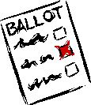
The Mix-Net Paradigm

Slide 79
The Mix-Net Paradigm
MIX
Vote
Vote
Vote
Vote

Slide 80
The Mix-Net Paradigm
MIX
Vote
Vote
Vote
Vote

Slide 81
The Mix-Net Paradigm
MIX
Vote
Vote
Vote
Vote

Slide 82
A Re-encryption Mix
MIX

Slide 83
A Re-encryption Mix
MIX

Slide 84
Verifiability
The mix provides a proof that its output is a permutation of re-encryptions of its input.

Slide 85
Multiple Re-encryption Mixes
MIX
MIX
Vote
Vote
Vote
Vote

Slide 86
Verifiability
Each re-encryption mix provides a mathematical proof that it’s output is a permutation of re-encryptions of its input.
Any observer can verify this proof.
The decryptions are also proven to be correct.
If a mix’s proof is invalid, its mixing will be bypassed.

Slide 87
Faulty Mixes
MIX
MIX
Vote
Vote
Vote
Vote

Slide 88
Recent Mix Work
1993 Park, Itoh, and Kurosawa
1995 Sako and Kilian
2001 Furukawa and Sako
2001 Neff
2002 Jakobsson, Juels, and Rivest

Slide 89
A Simple Verifiable Re-encryption Mix
Input Ballot Set
Output Ballot Set
MIX

Slide 90
Operation of a Re-encryption Mix
Input Ballot Set
Output Ballot Set
MIX

Slide 91
Operation of a Re-encryption Mix
MIX

Slide 92
Operation of a Re-encryption Mix
Inputs
Outputs
62951413
53124141
31415926
62951413
81828172
27182818
81828172
81828172
16180339
93308161
93308161
62951413
53124141
93308161
14142135
53124141

Slide 93
Re-encryption
Each value is re-encrypted by multiplying it by an encryption of zero.
This can be done without knowing the decryptions.

Slide 94
Verifying a Re-encryption
MIX
53124141
31415926
14142135
62951413
27182818
31415926
16180339
93308161
16180339
81828172
14142135
27182818

Slide 95
A Simple Verifiable Re-encryption Mix

Slide 96
Is This “Proof” Absolute?
The proof can be “defeated” if and only if every left/right decision can be predicted by the prover in advance.
If there are 100 intermediate ballot sets, the chance of this happening is 1 in 2¹⁰⁰.

Slide 97
Who Chooses?
If you choose, then you are convinced.
  But this won’t convince me.
We can each make some of the choices.
  But this can be inefficient.
We can co-operate on the choices.
  But this is cumbersome.
We can agree on a random source.
  But what source?

Slide 98
Who Chooses?
The Fiat-Shamir Heuristic
Prepare all of the ballot sets as above.
Put all of the data into a one-way hash.
Use the hash output to make the choices.
This allows a proof of equivalence to be “published” by the mix.

Slide 99
Jakobsson, Juels, and Rivest
MIX

Slide 100
Unconditional Verifiability
Each illegitimate output ballot will be detected with probability at least 0.5.
This detection is not dependent on any mathematical/complexity assumptions – only on unpredictability of the challenge.
Other methods can demonstrate that all ballots are correct unless all random challenges are predicted (enables use of cryptographic hash).

Slide 101
Mix-Net Properties
The integrity of a mix-net is not dependent on any unproven assumptions – only the inability of a mix to predict the challenges it receives (except possibly the hash).
Privacy in a mix-net is dependent upon the mixes and is no better than that provided by the encryption – a cryptographic break-through could compromise privacy.

Slide 102
So What
About Ballot
Encryption?

Slide 103
The Encryption Phase
How can voters turn their intentions into encrypted ballots?
Any device that can perform this task could have vulnerabilities, intentional back doors, be subject to viruses, etc.

Slide 104
Prêt à Voter Ballot
Joe Smith
John Citizen
Jane Doe
Fred Rubble
Mary Hill
 | 17320508

Slide 105
Auditing
Visual cryptography can be used to allow auditing to be accomplished by visual inspection of transparent receipts.
Encrypted codebooks can be used to give voters the opportunity to audit by verifying that a number displayed by the device matches a number on a printed receipt.
Clever ballot constructions can force voters to make “random” selections to promote auditing.

Slide 106
The Encryption Phase
Requirements of ballot encryption devices
Must accurately encrypt voter intentions
Need not know voter identities
Need not authenticate voters right to vote
Need not limit people to a single use
Need not cast votes

Slide 107
Auditing
Note that it’s not necessary for all voters to audit vote encryption devices – a tiny random fraction of voters and/or election inspectors can suffice.
E.g. 100 random auditing events would probably detect a 1% fraud rate.

Slide 108
Unstructured Auditing
Anyone … voter/inspector/observer is free to create votes at any time during an election.
Any “uncast” votes are opened (decrypted) for verification.

Slide 109
A Simple Audit
Go into vote encryption booth.
Create 4 encrypted ballots: 2 for each of candidate A and candidate B.
Leave vote encryption booth with 4 encrypted ballots.
Take one of the encrypted votes for each of A and B and have them decrypted.
Cast one of the 2 remaining encrypted votes.

Slide 110
A Fairly Simple Alternative
Go into vote encryption booth.
Create a single encrypted ballot.
Booth also creates commitments to ballot.
Voter presses one of two buttons.
Booth opens selected commitments to serve as externally verifiable proof.
Booth also creates fake commitments and proof of opposite ballot choice(s) based upon previously selected challenge button.

Slide 111
A Fundamental Limitation
Whenever a ballot is created for the voter, there seems to be no way to distinguish between a vote-creation device attempting to cheat and a voter claiming that a properly functioning device attempted to cheat the voter.

Slide 112
In Practice?
Typical Voter
Go to a polling station, sign in, receive a token.
Go to a stand-alone voting station.
Enter preferences interactively.
Receive a printed encryption of the completed ballot.
Get the question: “Do you want to cast this ballot?”
Answer “yes” and insert token to receive a copy of the encrypted ballot on the token signed as good for casting.
Leave token with poll worker.
Take printed receipt home and (if desired) use it to verify on-line that the vote hasn’t been altered.

Slide 113
In Practice?
Suspicious Voter or Observer
Go to a voting station.
Enter preferences interactively.
Receive a printed encryption of the completed ballot.
Get the question: “Do you want to cast this ballot?”
Answer “no” and receive a printed verifiable decryption of the encrypted ballot.
[Later] Verify the decryption of the ballot.
[Optional] Verify the posted ballot mixing and decryptions using posted proofs.

Slide 114
In Practice?
Election Officials
Receive all votes and post them on-line (perhaps even together with voter names).
Allow anyone to (sequentially) scramble (mix) the votes and provide a proof of correct mixing. Post all such mixings and proofs on-line.
Have the final mixed ballots decrypted together with proof of correct decryption. Post the decryptions together with their proofs.

Slide 115
In Practice – OpScan Version
Typical Voter
Go to a polling station, sing in, and receive an OpScan ballot.
Fill out ballot as usual.
Feed completed ballot into precinct scanner.
Scanner prints receipt including encrypted ballot.
Get the question: “Do you want to cast this ballot?”
Answer “yes” and take receipt home.
If desired, verify on-line (or in newspaper) that the encrypted ballot is properly included.

Slide 116
In Practice – OpScan Version
Suspicious Voter or Observer
Go to a polling station, sing in, and receive an OpScan ballot.
Fill out ballot as usual.
Feed completed ballot into precinct scanner.
Scanner prints receipt including encrypted ballot.
Get the question: “Do you want to cast this ballot?”
Answer “no” and receive a printed verifiable decryption of the encrypted ballot.
[Later] Verify the decryption of the ballot.
[Optional] Verify the posted ballot mixing and decryptions using posted proofs.

Slide 117
In Practice – OpScan Version
Election Officials
Receive all votes and post them on-line (perhaps even together with voter names).
Allow anyone to (sequentially) scramble (mix) the votes and provide a proof of correct mixing. Post all such mixings and proofs on-line.
Have the final mixed ballots decrypted together with proof of correct decryption. Post the decryptions together with their proofs.

Slide 118
Properties
Cryptographically verified election technologies can achieve universal end-to-end verifiabilty, while pure paper and “voter-verifiable paper audit trail (VVPAT)” systems only provide administrative and limited voter verifiability.
This is a substantially different paradigm that emphasizes certification of elections rather than election equipment.
The integrity of a cryptographic election can be verified externally without ever having to inspect the system hardware or software.

Slide 119
Scorecard
 | Crypto Based | Paper Based
Accuracy/ Verifiability
Privacy/ Coercibility
Robustness/ Availability
Usability/ Voter Error
Overall

Slide 120
Scorecard
 | Crypto Based | Paper Based
Accuracy/ Verifiability | Fully end-to-end verifiable by anyone | Voter can only verify as far as ballot box
Privacy/ Coercibility
Robustness/ Availability
Usability/ Voter Error
Overall

Slide 121
Scorecard
 | Crypto Based | Paper Based
Accuracy/ Verifiability | Fully end-to-end verifiable by anyone | Voter can only verify as far as ballot box
Privacy/ Coercibility | Cannot be proven absolutely | Cannot be proven absolutely
Robustness/ Availability
Usability/ Voter Error
Overall

Slide 122
Scorecard
 | Crypto Based | Paper Based
Accuracy/ Verifiability | Fully end-to-end verifiable by anyone | Voter can only verify as far as ballot box
Privacy/ Coercibility | Cannot be proven absolutely | Cannot be proven absolutely
Robustness/ Availability | Wholesale failure is possible | Only retail failure is possible
Usability/ Voter Error
Overall

Slide 123
Scorecard
 | Crypto Based | Paper Based
Accuracy/ Verifiability | Fully end-to-end verifiable by anyone | Voter can only verify as far as ballot box
Privacy/ Coercibility | Cannot be proven absolutely | Cannot be proven absolutely
Robustness/ Availability | Wholesale failure is possible | Only retail failure is possible
Usability/ Voter Error | Fully-interactive voting device | Paper
Overall

Slide 124
Scorecard
 | Crypto Based | Paper Based
Accuracy/ Verifiability | Fully end-to-end verifiable by anyone | Voter can only verify as far as ballot box
Privacy/ Coercibility | Cannot be proven absolutely | Cannot be proven absolutely
Robustness/ Availability | Wholesale failure is possible | Only retail failure is possible
Usability/ Voter Error | Fully-interactive voting device | Paper
Overall | ? | ?

Slide 125
Conclusions
Keep an open mind.
Think critically.
Vote!

Slide 126
Resources
See
http://research.microsoft.com/crypto/voting/
for some pointers to further information.

